Slide 1
Student Polling
Web Application
Reece Panek
Dr. Bo Hatfield

Slide 2
Objectives
Create an interactive web application to allow for a more interactive and engaged classroom.
Provide data on how well students are understanding the concepts in class and provide a resource for students to study from

Slide 3
What I Am Getting Out Of This
Completing a project from beginning to end
Gain better understanding in connecting back-end to front-end
Practice creating, populate, updating and retrieving a database
Practice creating a user-friendly interface

Slide 4
Problem Specification
Example: An instructor is having problems keeping the attention of their students
Solution: A web-based application that will keep students attention in the class by allowing everyone to be able to participate in class

Slide 5
Problem Specification - Students
Allows the student to sign into class and receive uploaded images from the instructor
The student can answer questions anonymously with the press of a button that will be saved and neatly organized for the class to view
Students can go back in the future to be able to view the questions/answers for study purposes

Slide 6
Problem Specification - Instructor
Create Multiple Choice and True or False questions
Keeps students engaged and paying attention to increase grades
Sort questions by topic and receive student averages for future reference
Keeps track of students grades on the questions and their attendance in class

Slide 7
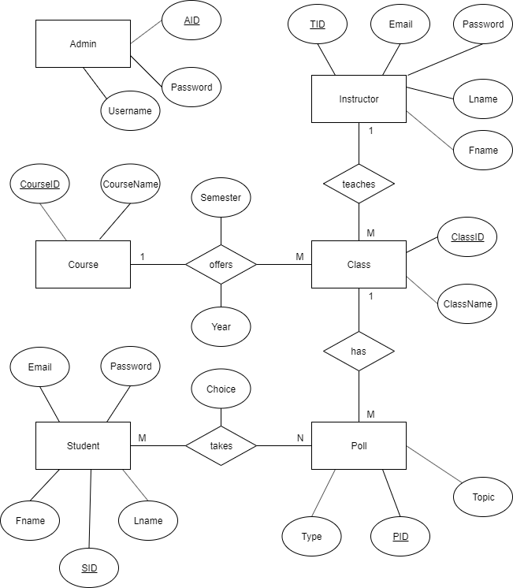
Preliminary
ERD

Slide 8
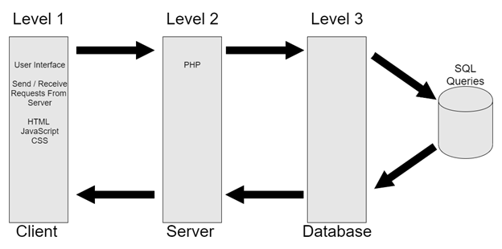
System Architecture

Slide 9
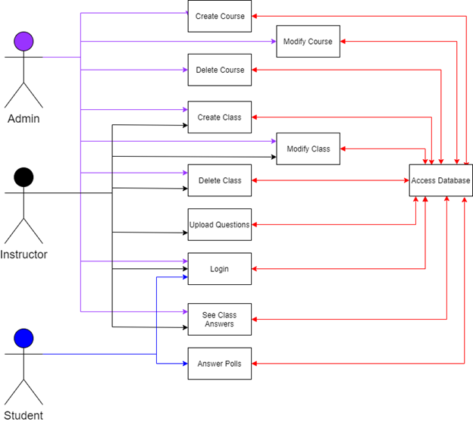
Usage Diagram

Slide 10
Prototype
http://weblab.salemstate.edu/~S0313537/StupollProto/

Slide 11
Tool List
Server - weblab.salemstate.edu
Lamp Stack
APACHE
MySQL
PHP
PHPMYADMIN
OS
Linux
Windows 10
IDE
Visual Studio
Languages
CSS
HTML
PHP
Javascript
Mobirise4 (Website Builder)
ECharts (Drawing Tool)
Version Control
GitHub

Slide 12
Benchmarks
Back-End Database Implementation
Instructor
Student
Admin
Instructor Functionality, Implementation / Testing
Student Functionality, Implementation / Testing
Admin Functionality, Implementation / Testing
Integrated Testing

Slide 13
Time Schedule
Component Implementation | Time Allocated
Back-End Database Implementation | 3 weeks
Instructor Functionality, Implementation / Testing | 3 weeks
Student Functionality, Implementation / Testing | 3 weeks
Admin Functionality, Implementation / Testing | 2 weeks
Integrated Testing | 2 weeks
Report / Presentation Preparation | 1 week

Slide 14
Grading Scheme
Component | Grade
CSC 521 Presentation | 10%
Back-end | 25%
Instructor | 20%
Student | 15%
Admin | 10%
Report | 10%
Integrated Testing | 10%

Slide 15
Deliverables
Original Presentation
Original Proposal
Amendments
System Architecture Diagrams
Project Version Control URL
User Manual
Sample Output
Project Journal
Postmortem
Final Presentation / Report
Zip of All Files

Slide 16
Conclusion
Create a free resource to increase learning and productivity
More engaged classroom
Study tool for students
Information for instructors that can be used in future semesters

Slide 17
Any Questions?

